Slide 1
FIJI Higher Education Commission Forum 2022:
“The Role of Higher Education Institutions in Developing Human Capital “
PROFESSOR SIMON WILKIE Dean, Faculty of Business and Economics Head, Monash Business School

Slide 2
WHO IS THIS GUY?
Dean, Faculty of Business & Economics and Head, Monash Business School, Monash University, Australia
Microsoft Chief Economic Policy Strategist and Chief Economist WWPS
PhD 1990, U. Rochester
Former Chief Economist of FCC
Former Chair Economics Dept. USC
Taught at Caltech, Columbia, USC

Slide 3
WHAT IS A CHIEF ECONOMIST?

Slide 4
The Knowledge Economy
Human Capital is The Driver of Economic Growth
Paul Romer Nobel Prize
Positive Externalities – More Human Capital makes more Human Capital incrementally more valuable
Increase in geographic specialization
Positive Assortative Matching
40% of all New GDP in US since CFC came form one place!
Impact of 4th Industrial Revolution

Slide 5
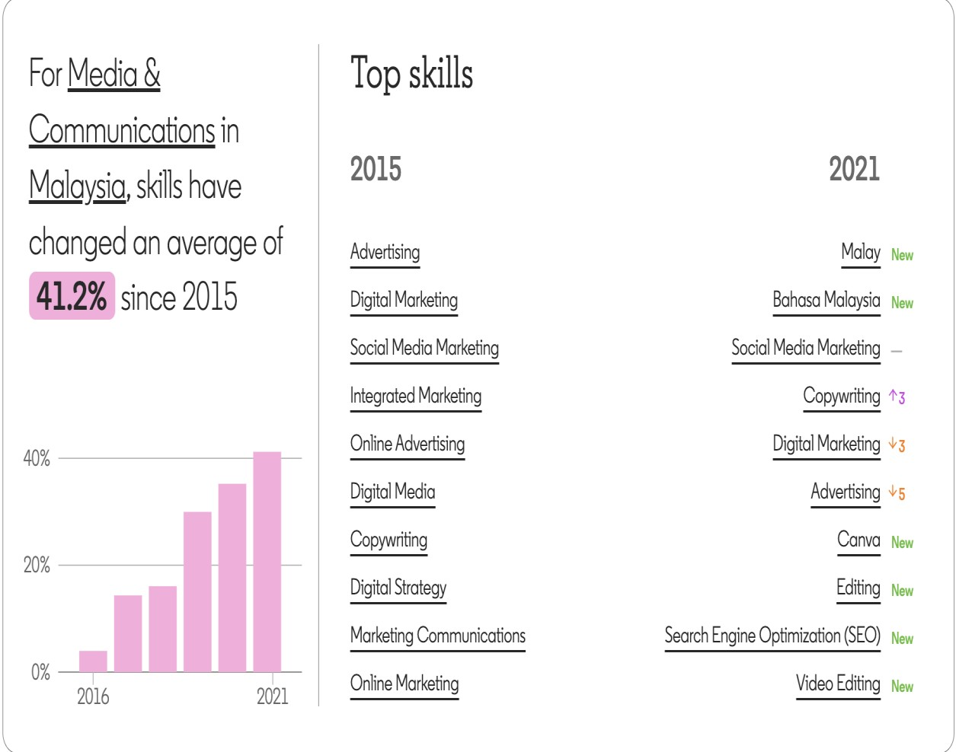
There’s a growing gap between the skills of today’s
workforce and the skills needed for future success
What’s happening now
Skills are changing quickly
50%
of all employees
will require significant up skilling by 2025
33%
of core job skills
will change in the next 5 years
LinkedIn economic graph data 2015-2021
World Economic Forum “Future of Jobs” report 2020

Slide 6
Skills Mismatch: A National Dilemma
41k
Grads remained unemployed
454k
Open Jobs
782k
Unemployed
Sources:
Trading Economics /Bank Negara Malaysia, Jan 2021;
Department of Statistics Malaysia, Jan 2021;
Ministry of Education’s Graduate Tracer Study 2019

Slide 7
VIGNETTES – ALL IN USE TODAY
Sensors in fields direct irrigation, pesticides
X-Ray, MRI analyzed by machines
MSR melanoma app beats best experts in diagnostics
Chat-bot answers X-Box user’s problem
Driving behavior, alertness monitored by OBD2
My Insurance rates determined by my behavior not population average
Delve introduces 2 managers to discuss specific topic
Police dispatched to warehouse by video monitoring software

Slide 8
4th INDUSTRIAL. REVOLTION or DIGITAL TRANSFORMATION
Cheap sensors + connectivity + cheap data storage + machine intelligence
=
Universal Ambient Intelligence
Notes:
Thesis of this talk; focus is how to get ready

Slide 9
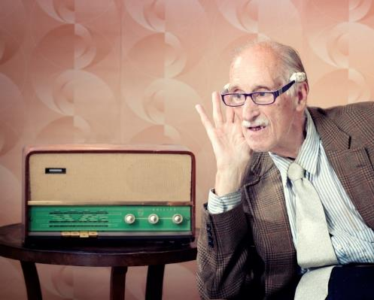
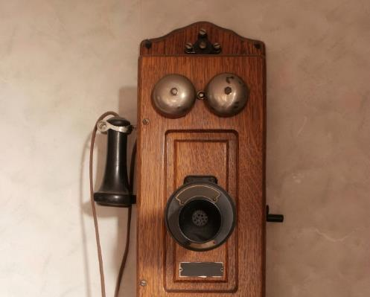
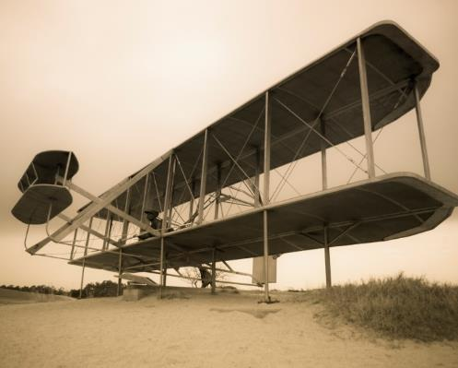
NOT SINCE THE EARLY 1900s…
have we seen this level of technological innovation.
Notes:
Automobile
Airplane
Telephone
Radio
Electric lights
Phonograph
Half the population leave the farm
Not 1900 have we seen the dramatic changes that are coming

Slide 10
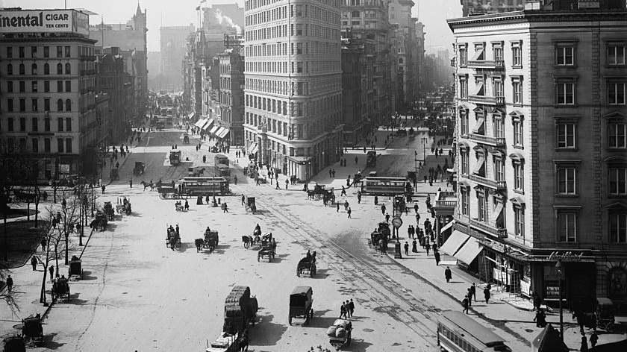
Notes:
A pair of photographs of the Flatiron Building in New York City taken in the early 1900s has deep relevance for this moment in history.
The images are nearly identical. Except for one thing.
In the first picture, taken in 1905, horses are the primary mode of transportation.

Slide 11
Notes:
Two decades later, automobiles fill the streets and line the curb.
In between lies a period of profound transformation.
At the beginning of the twentieth century, it took more than 100,000 horses to keep New York moving.
Thousands of people worked to drive them, feed them, and clean up the mess they left behind.
Then, as hay-fed horsepower gave way to oil-fueled horsepower, the world changed dramatically.
Within a quarter century, entire industries built on horses had all but disappeared.
And a society that moved at the speed of cars rather than the trot of horses struggled to create new laws and build new infrastructure as a wave of innovation launched a new economy
An economy that was more productive, more dynamic, and that created millions of new good-paying jobs.

Slide 12
TECHNOLOGICAL ACCELERATION
Mobility (devices, data, intelligence)
Virtual Office
IoT (ubiquitous comms, cheap chips)
Cloud (VLS computing)
Machine intelligence
Big data
Mobile payment systems
Personalization
Voice control, conversational
Virtual reality
Silicon photonics
Software writing software
3-D printing
Wearables & quantified self
Cyber attacks
Online markets
Lightweight, low altitude satellites
Drones
Native advertising
Driverless vehicles
Robotics, industrial automation
Adaptive, gamified education
Near-instant product delivery
Freelance employment model
Assetless company
Nano-machines
Genomics
Economical solar, wind, tidal power
Notes:
Placeholder slide for disruption – currently vetted
There’s Uber, the world’s biggest taxi service, which owns no vehicles.
Airbnb, the world’s most valuable lodging company, which owns no hotels and.
And companies like Square are creating payment services for business around the world, and yet has no branches

Slide 13
WHAT INDUSTRY SAYS
436
23%
45%
global business leaders survey
are confident their organisations have the knowledge and skills to succeed in the digital aspects of their business.
said they personally had the technology knowledge they need to succeed in their jobs.
Source: A Harvard Business Review Analytic Services Report sponsored by RedHat
https://enterprisersproject.com/article/2015/5/new-hbr-research-urges-cios-lead-digital-transformation
Notes:
Motivation: there is widespread concern among executives that tech is speeding up and getting away from us.
If anything, the 45% who think they have the knowledge they need are overconfident.

Slide 14
WHAT IS COMING?
New markets
Uber is just the beginning
New organizational forms
New types of contracts
New Jobs
Focus of Today’s Talk

Slide 15
WHAT IS COMING?
New markets
Uber is just the beginning
New organisations
Delve is just the beginning
New contracting
Intelligent measurement
New jobs

Slide 16
NEW MARKETS
Power – smart grids with dynamic markets
Mobility as a service
Spectrum/connectivity dynamic spectrum allocation
Real time, on demand, imaging
Movement of things in the physical world
Employment
Virtual companies
Education
Professional services
Simple tasks (dog-walking)
Shopping
Notes:
Energy – real time energy markets, automated devices
Spectrum – real time connectivity pricing
Imaging – give me a picture of my home right now
Get this package from here to there
Employment – completely upended

Slide 17
WHAT IS COMING?
New markets
Uber is just the beginning
New organisations
Data driven management
New contracting
Intelligent measurement
New jobs

Slide 18
GARTNER SAiD
By 2018
Robot overlords Smart machines will distribute 10% of human work.
By 2020
Four out of 10 high performers will distribute their work across a team of "virtual doppelgangers" to boost their personal productivity.
As much as 65% of knowledge worker career paths will be disrupted by smart machines.
Non-routine work will account for more than 65% of U.S. jobs.
Source: Workplace Reimagined: Four Scenarios to Help Visualize the Future
Hanns Koehler-Kruener, Carol Rozwell, Frank Buytendijk, Gartner, February 25, 2015
Notes:
I wouldn’t be surprised if we have already hit 10% of workers dispatched by machines
According to the NBER we are at 75% non-routine, no need to wait to 2020
I’m skeptical about the virtual doppelgangers but we are already automating some of the wisdom of the salesforce by improving lead generation with ML.
The better prediction is that we will take the behavior of high performers, figure out what they are doing, and extend it to others

Slide 19
RAPID RESTRUCTURING & CHANGE MANAGEMENT
Change business practices much more quickly
Automate employee, resource assignments
Create new, virtual teams or virtual companies
Rapidly prototype new products
Launch web-based channel and scale as needed
Notes:
Concept to sale cycles can be reduced by half and half again
Machines will construct dream teams of employees with optimal skill sets
Firms will evolve more rapidly
Best practices are discovered and spread much more rapidly
That invisible know-how that makes organizations effective will be embedded in software

Slide 20
WHAT IS COMING?
New markets
Uber is just the beginning
New organisations
Delve is just the beginning
New contracting
Intelligent measurement
New jobs

Slide 21
NEW CONTRACTING METHODOLOGIES
New signals and measurement
Insurance rates depend on driving behavior
AI
Predict salesperson success, determine compensation
Auctions and bidding
e.g. crowd-sourced logo
Personalization (Price discrimination)
Based on time of day, day of week
Geography
Other purchases
AI-based models

Slide 22
WHAT IS COMING?
New markets
Uber is just the beginning
New organisations
Delve is just the beginning
New contracting
Intelligent measurement
New jobs

Slide 23
THE END OF THE WORKPLACE
Notes:
It is the end of the cubical
Fast delivery, Information everywhere, employees connected
Sales, customer care, programming, can be distributed
Virtual teams not employees

Slide 24
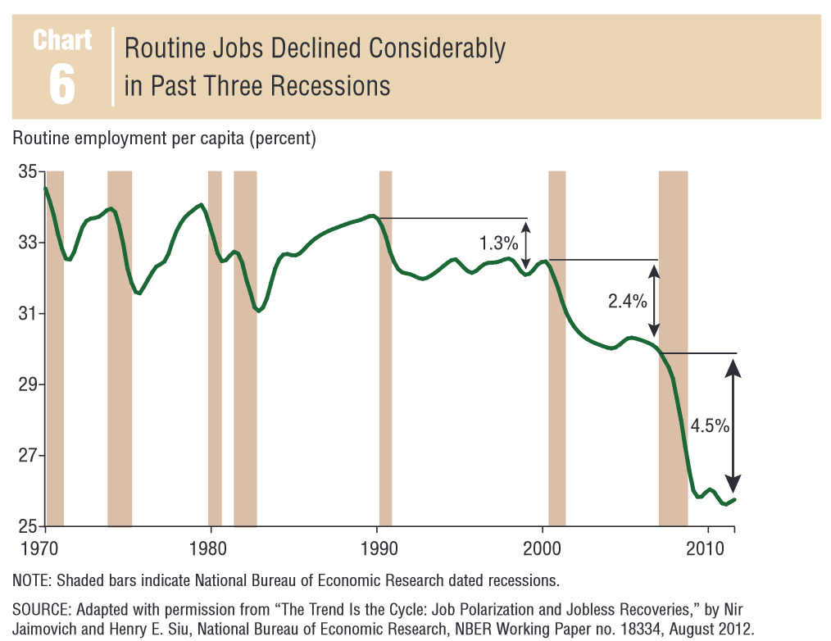
CHANGING EMPLOYMENT TO NON-ROUTINE
In the past jobs were lost in recessions but came back in the recovery.
Since 1990 in each recession routine jobs were destroyed. They do not come back. The trend has been increasing.
http://www.dallasfed.org/assets/documents/research/eclett/2014/el1405.pdf
Notes:
Every recession knocks out more routine employment, NBER, the people who call recessions, say we are down to 25% in the US.

Slide 25
COMPLEMENTS AND SUBSTITUTES
A complement makes something more valuable
Xbox and controller
One person with a bulldozer does the work of hundreds with shovels
Initially reduces employment of diggers
Drives up wages: requires greater skill
Cost of earth-moving falls
More earthmoving
Employment may go up or down
25

Slide 26
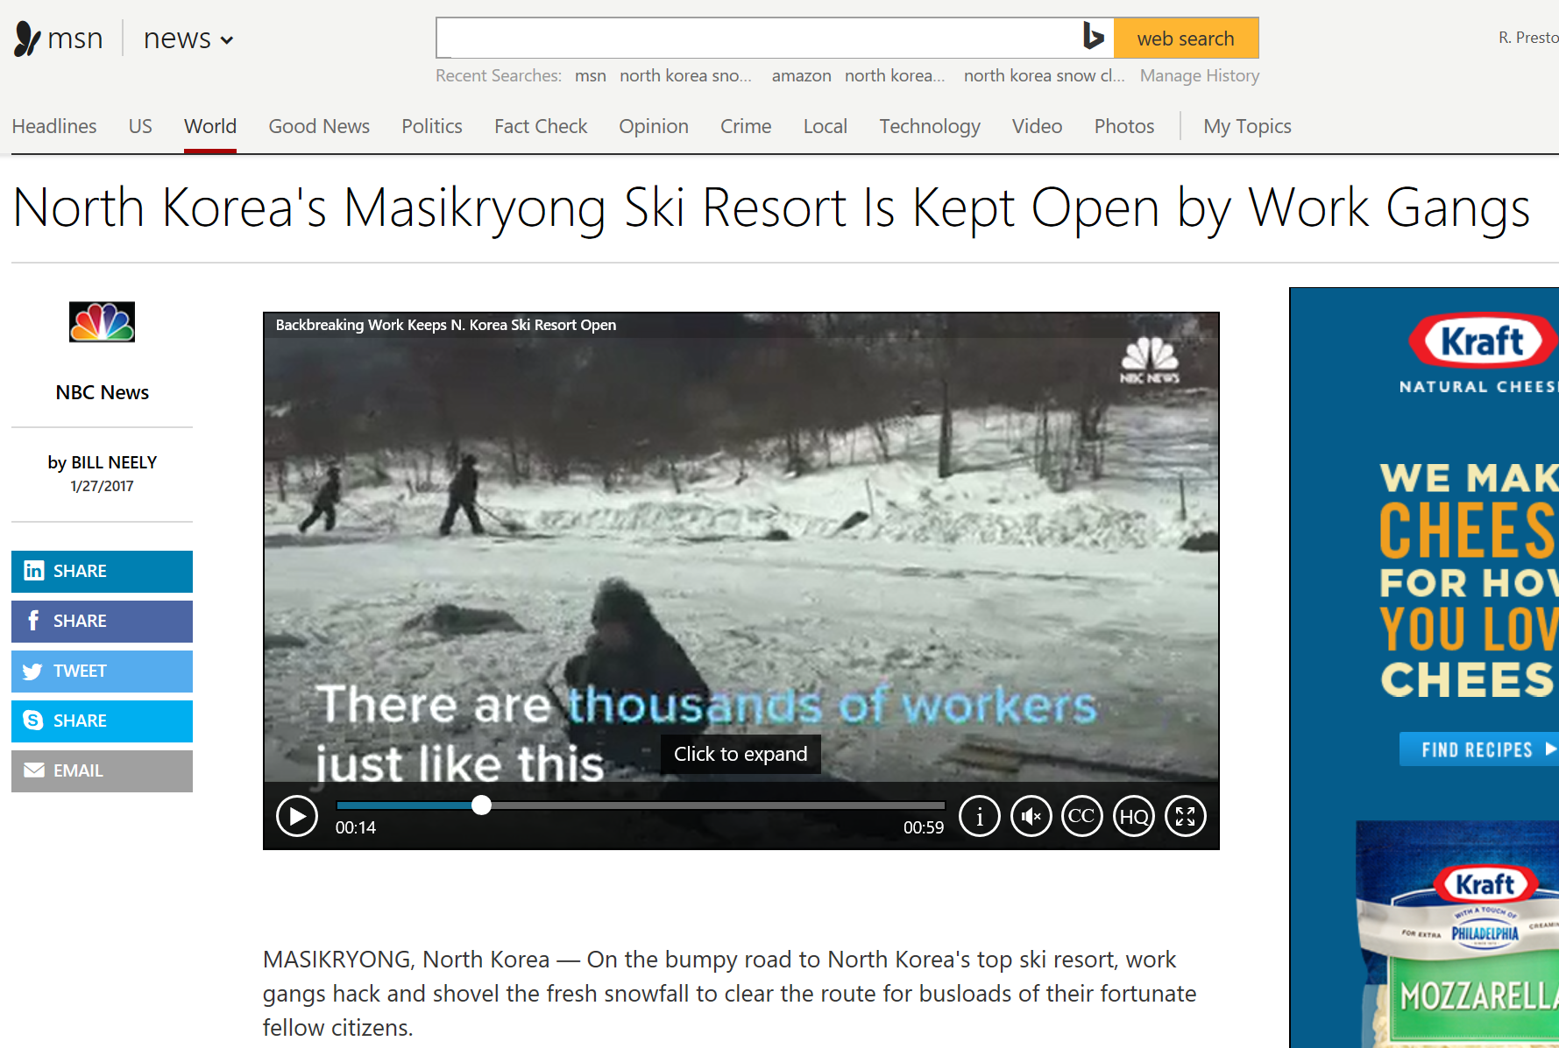

Slide 27
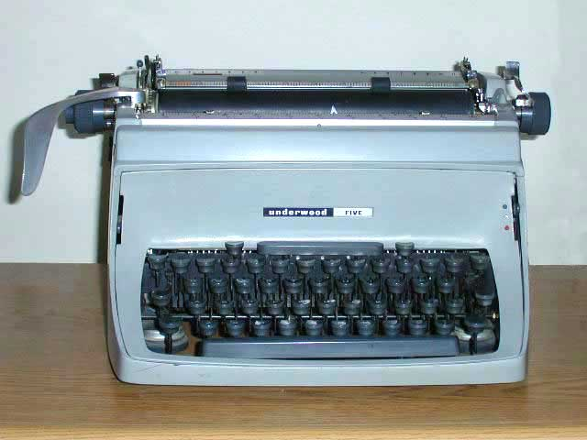
COMPLEMENTS AND SUBSTITUTES continued
Cotton Gin
Adding machine in fast food restaurant
Substitutes for math skills
Reduces skill level
Wages fall, employment rises
Word processing
Reduced secretarial wages

Slide 28
EFFECTS ON WAGES
1750 – 1900: “Deskilling”
Machines + low skilled workers substituted for skilled artisans
Pin factory, Cotton gin
Wages flat or fall, increasing inequality
1875 – 1980: Machines complement skills
Bulldozer, assembly line, services
Middle-class wages rise, decreasing inequality
1980 – 2017: Machines substitute for skills
Wages flat for bottom 60%
Widening skill gap, “college premium”, increasing inequality
Increasing “underemployment”
2017 – 2100: Is AI a substitute or complement?

Slide 29
JOBS DISAPPEARING IN 20TH CENTURY (% OF TOTAL)
Servant
Other labourer
Farmer
Farm labourer
Source: Wyatt and Hecker, Occupational changes in the 20th Century via Calverley Economic Advisors

Slide 30
NEW JOBS 20TH CENTURY (% OF TOTAL)
Services roles
Managers, officials
Clerical, admin
Professional, technical

Slide 31
JOB LOSSES 2000-15
000’s | 2000 | 2015 | Δ%
Production | 12,400 | 9,073 | -27
Office and admin | 22,936 | 21,846 | -5
Management | 7,783 | 6,936 | -11
Construction, extraction | 6,187 | 5,478 | -11

Slide 32
NEW JOBS 2000-15
000’s | 2000 | 2015 | Δ%
Food preparation, serving | 9,955 | 12,577 | 26
Biz, financial operations | 4,610 | 7,032 | 53
Health practitioners | 6,041 | 8,021 | 33
Personal care | 2,701 | 4,307 | 59
Education, training, library | 7,451 | 8,542 | 15
Computing and maths | 2,933 | 4,005 | 37
Sales | 13,507 | 14,462 | 7
Healthcare support | 3,039 | 3,990 | 31

Slide 33
ANOTHER PERSPECTIVE
100 years ago, 33% of us grew food. Now 2%
40 years ago 22% made ‘things’. Now 8%
Automation increasingly takes service jobs
But… purchases of rich spread to middle class
Predicts future jobs

Slide 34
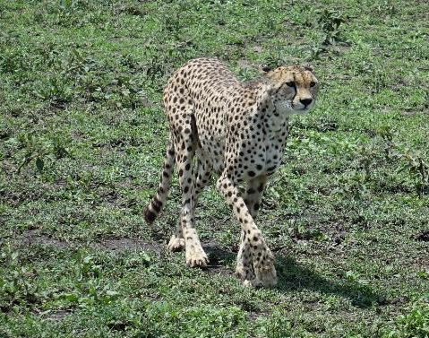
WHAT DO THE TOP 5% BUY NOW?
Fancy construction
Craft & designer items
Fine dining
Entertainment – sports, theatre, tourism
Personal trainers, massage, beauty

Slide 35
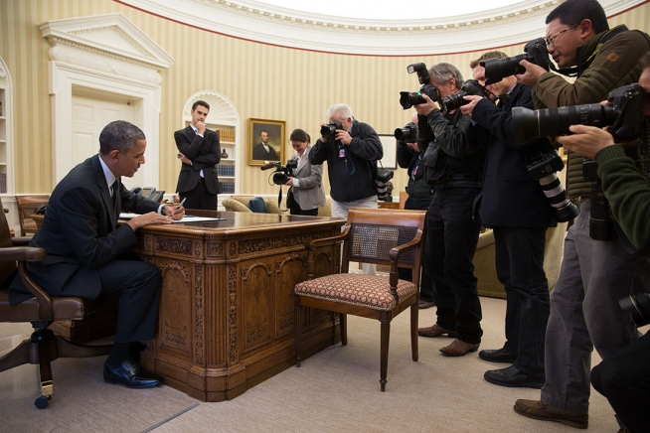
JOBS continued
New technologies create new job roles
But this has been shrinking over time, below 1%
Jobs come where humans are better
Communications
Creativity
Care (especially where empathy needed)
Service

Slide 36
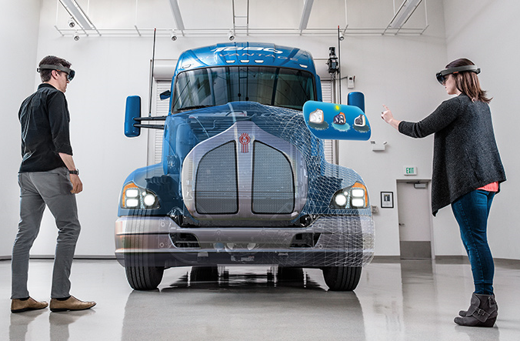
SUBSTITUTE OR COMPLEMENT?
Complements – increase wages
Delve, DeepCRM, Hololens, Office
Design tools, 3-D printers
Substitutes – decrease wages/increase inequality
Turbo-Tax
Medical diagnostics
Driverless shuttle bus

Slide 37
TECHNOLOGIES: SUBSTITUTES & COMPLEMENTS
Mobility (devices, data, intelligence)
IoT (ubiquitous comms, cheap chips)
Cloud (VLS computing)
Machine intelligence
Big data
Mobile payment systems
Personalization
Voice control, conversational
Virtual reality
Silicon photonics
Software writing software
3-D printing
Wearables & quantified self
Worsening cyber attacks
Online markets
Lightweight, low altitude satellites
Drones
Native advertising
Driverless cars
Robotics, industrial automation
Adaptive, gamified education
Near-instant product delivery
Freelance employment model
Assetless company
Nano-machines
Genomics
Economical solar, wind, tidal power

Slide 38
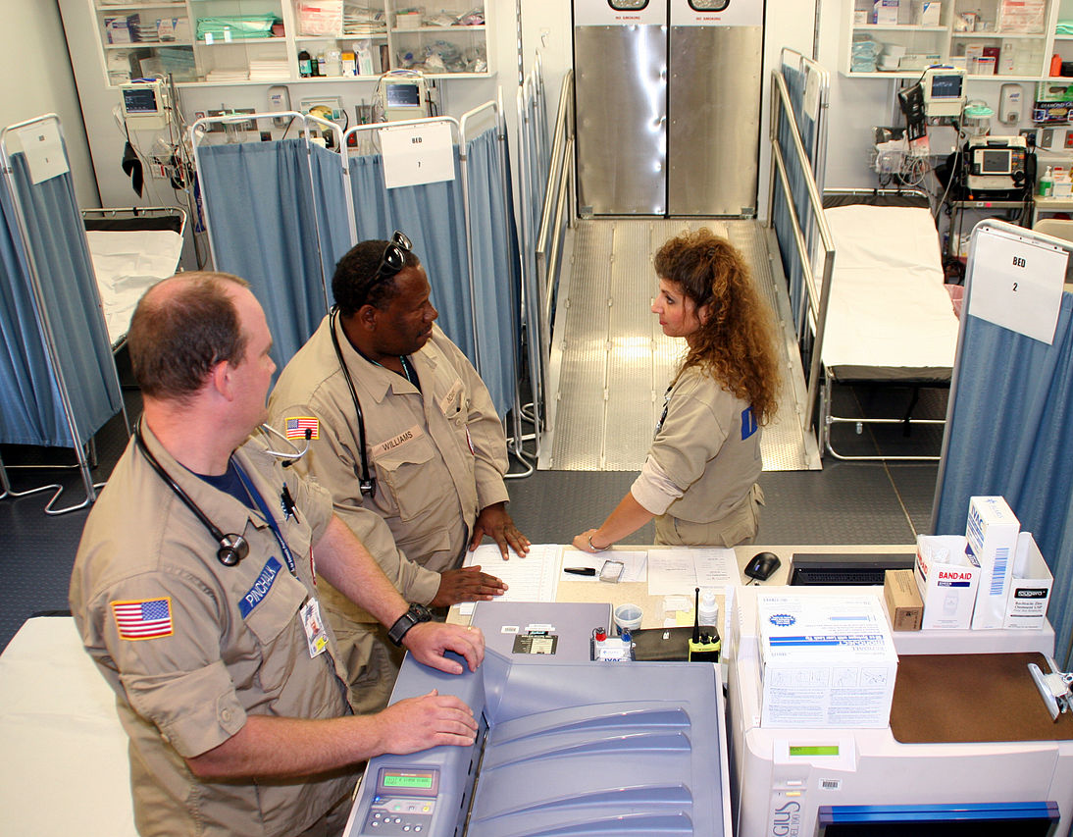
WHAT ARE GROWTH INDUSTRIES FOR THIS CENTURY?
The tasks that make us human
Communications and persuasion
Creativity and invention
Care and Empathy
How to thrive?
Treat AI and automation as a tool
Expect to learn new tools
Life long learning!!!!
New social contract?
Digital inclusion
Self worth/identity

Slide 39
THANK YOU

