Slide 1
Partnership
Notes:
I am TIM of TIT……

Slide 2
“Working with towards agreed upon outcomes”
Notes:
Digital Literacy, Blended Learning options, working with non-traditional partners (UNPRAC),

Slide 3
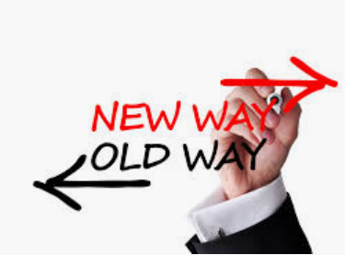
Contemporary Training Models….
Notes:
Moving from an area of comfort (scholarships, Traditional F2F delivery)
Presenting opportunities for ding things differently but ensuring the same quality Same-Same, but different,
Skill Sets (E-Citezen) Short courses (IST) TAE Upgrade (currently being piloted) Flexible learning (FNU example),Blended and E-learning (PLAN International, Catapia)
RPL
This little fellow may look like a goldfish jumping into the unknown, I see a Salmon Leaping out of the estuary

Slide 4
To seize opportunities we must have the right skills, knowledge, tools and resources (and know how to use them!)
Notes:
Efficient programs, not wasting time and money, creating sustainable programs (ITAC Vanuatu example)
Soft copy resources, online delivery, recording lessons/lectures and uploading them onto an online platform (Moodle, Basecamp, Google Drive, BB)

Slide 5
Ensuring quality outcomes
Notes:
Same-Same but Different. Same quality, Same consistency of a proven brand, but different methods. RPL, flexible learning

Slide 6
Strengthening TVET partnerships
Notes:
External FNU, USP, FHEC, VIT, PomTec, DFAT, SPC (Validator example) TVET (Vanuatu example, remote delivery in Santos)
Co-Contribution, facilitating empowerment and mutual responsibility. Internal partnerships-investing in our own staff, tutor development and support (Raj example), ongoing support for trainers (PD F2F and online through My Village, or Connect), ensuring staff are involved in TQ PLC’s,
Thinking and Working politically to create mutually beneficial partnerships that strengthen the Pacific and our partners positions
Working with DFAT initiatives such as the Labour mobility program to create realistic migration pathways for Pacific Island people

Slide 7
Meeting Industry need
Notes:
Working together to raise the standard of TVET in the Pacific. Showcasing and raising the profile of TVET throughout the Pacific, ensuring that TVET is valued, SPTO worksho[

Slide 8
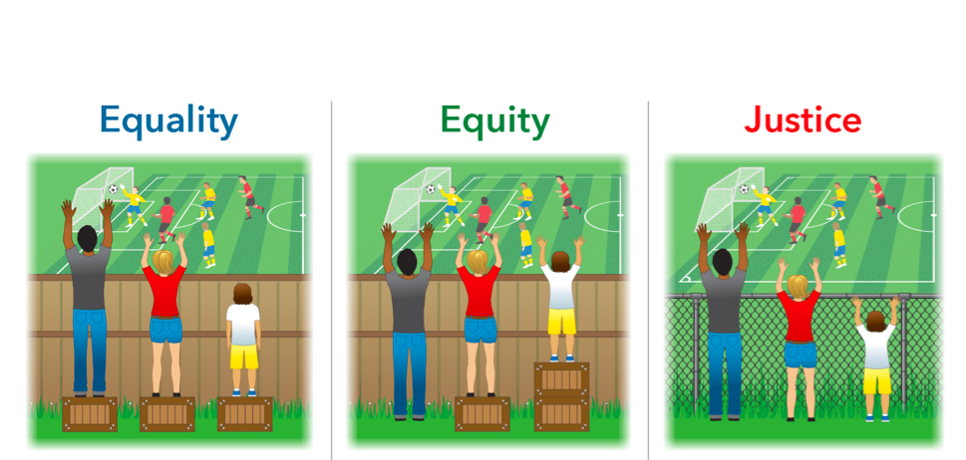
GESI
Notes:
Developing programs that meet the needs of those who need it the most, focusing on Gender, PLWAD programs, and working with International partners to deliver programs.
Responses to GBV in the Workplace
Small island state programs (Tuvalu, Naru, Kirribati)

Slide 9
Making Strategic partners
Notes:
What went before was grand, what we need to build in the future can help re-shape TVET in the Pacific. No more talking about what was, or what will be, but shaping what already is

Slide 10
Thank You

