Slide 1
Fiji Higher Education Forum Day 3 – TVET Stakeholders Perspectives

Slide 2
Session 1
Welcome & Opening
Fiji TVET Landscape & Direction

Slide 3
Session 2
Objectives of the day
Review of What Has Happened: “How Change Happens - Stakeholders Perspectives”

Slide 4
Session 2
Objectives of the day
Provide an overview of the current Fiji
TVET landscape
Participants are aware of the future direction of TVET in the context of Higher Education in Fiji
Gather perspectives of stakeholders to feed into the development of the National TVET Policy
Participants are aware of the current opportunities, challenges and stakeholders in the sector

Slide 5
Session 8: Next Steps & Closing
Session 7: How can we best add value – NATI
Session 6: Feedback & Discussion
Session 1: Welcome-Opening & TVET Landscape & Direction
Session 2:
Objectives of the day & Review of what has happened
Session 3:
Thought Leader Enabling TVET Policy for All
Session 5: World Café
Session 4: Panel Discussion 1& 2

Slide 6
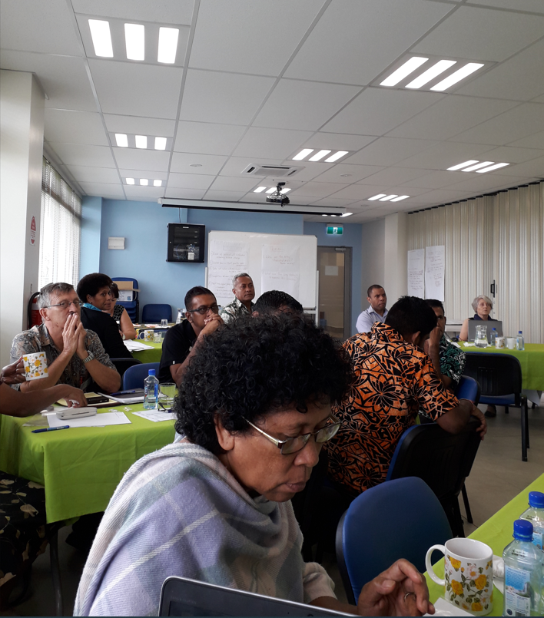
Session 2: So what has happened?
First Theory of Change workshop
2nd to 3rd May 2019

Slide 7
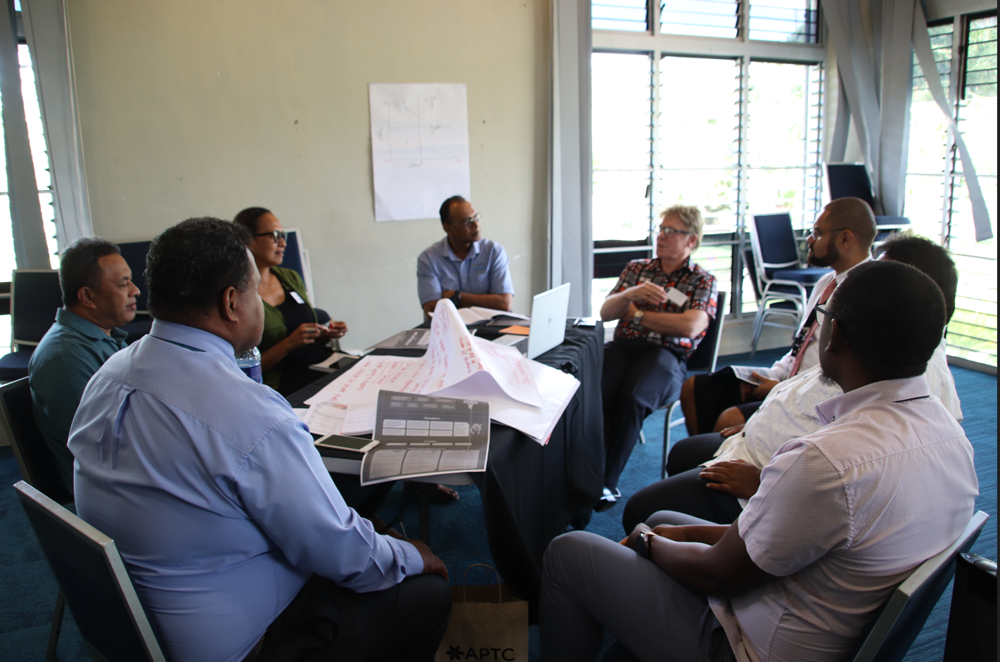
Review of Theory of Change
30th July 2020
First Wave of COVID
March 2020

Slide 8
Second Wave of COVID
May 2021
TVET Forum
15 July 2022

Slide 9
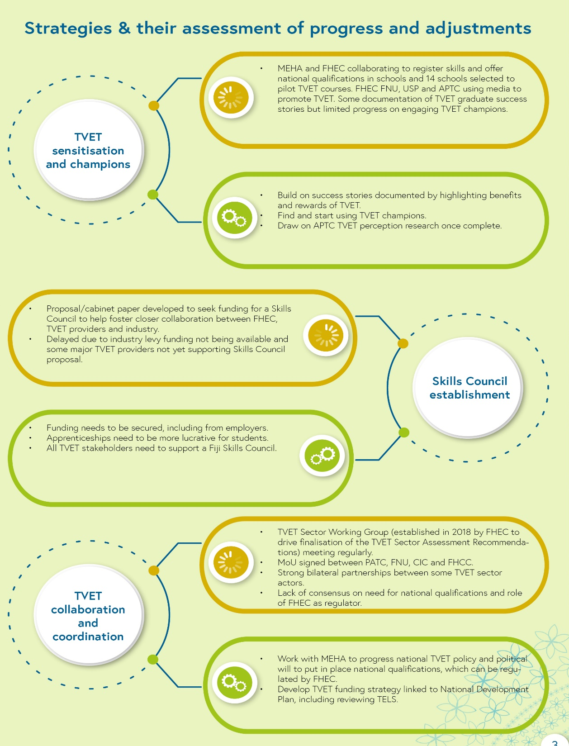
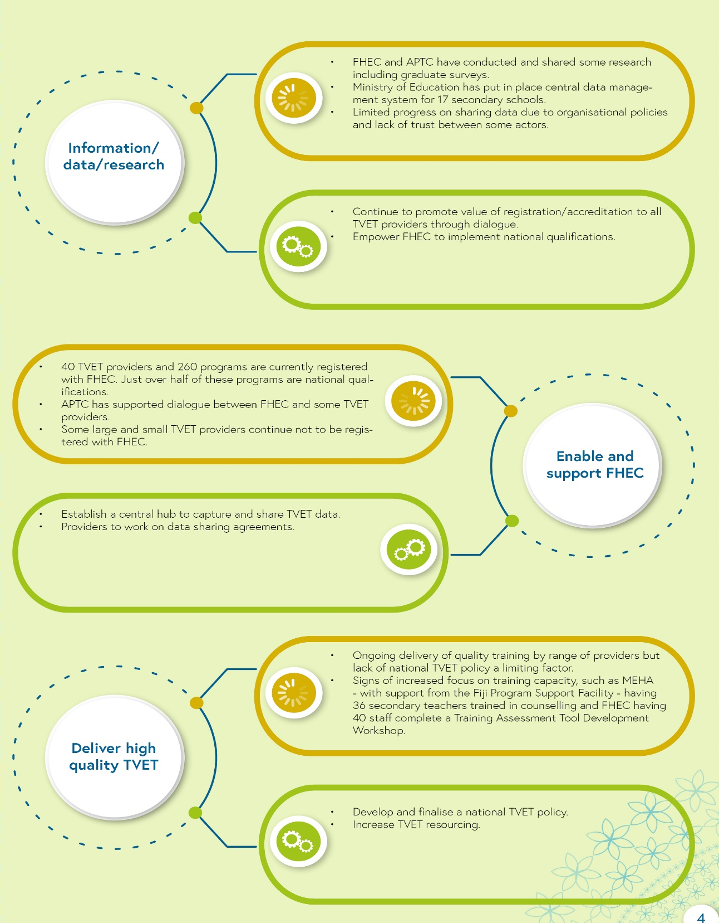

Slide 10
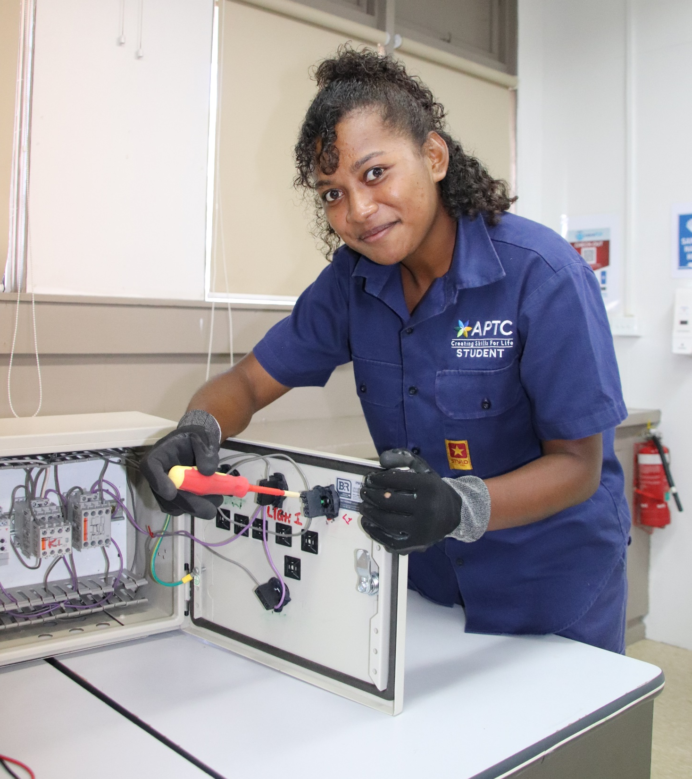
Session 3
Thought Leader:
An overarching and enabling TVET Policy environment for All
What does this mean and look like for All?

Slide 11
MORNING TEA see you back in 20 minutes

Slide 12
Session 4: Panel Discussion 1
The enablers of a robust and enabling TVET Policy environment
Key Question:
What key areas should the National TVET Policy
hope to address and why?

Slide 13
Lunch Break See you back in an hour!

Slide 14
PARTICIPANT ACTIVITY

Slide 15
Session 4: Panel Discussion 2
Beneficiaries of a robust and enabling TVET Policy environment
Key Questions:
Why TVET training? What are the current challenges going into TVET training and coming out and into employment?
How should the National TVET Policy be addressing to ensure clear training and employment pathways?

Slide 16
Meet Mr Aseri Tabuawaiwai!
National TVET Policy – Local Consultant
Email: atabuawaiwai@gmail.com

Slide 17
PARTICIPANT ACTIVITY

Slide 18
AFTERNOON TEA See you back in 20 minutes

Slide 19
Session 7: How can stakeholders best add value?
Experiences from Navuso Agriculture Technical Institute (NATI)

Slide 20
PARTICIPANT ACTIVITY

Slide 21
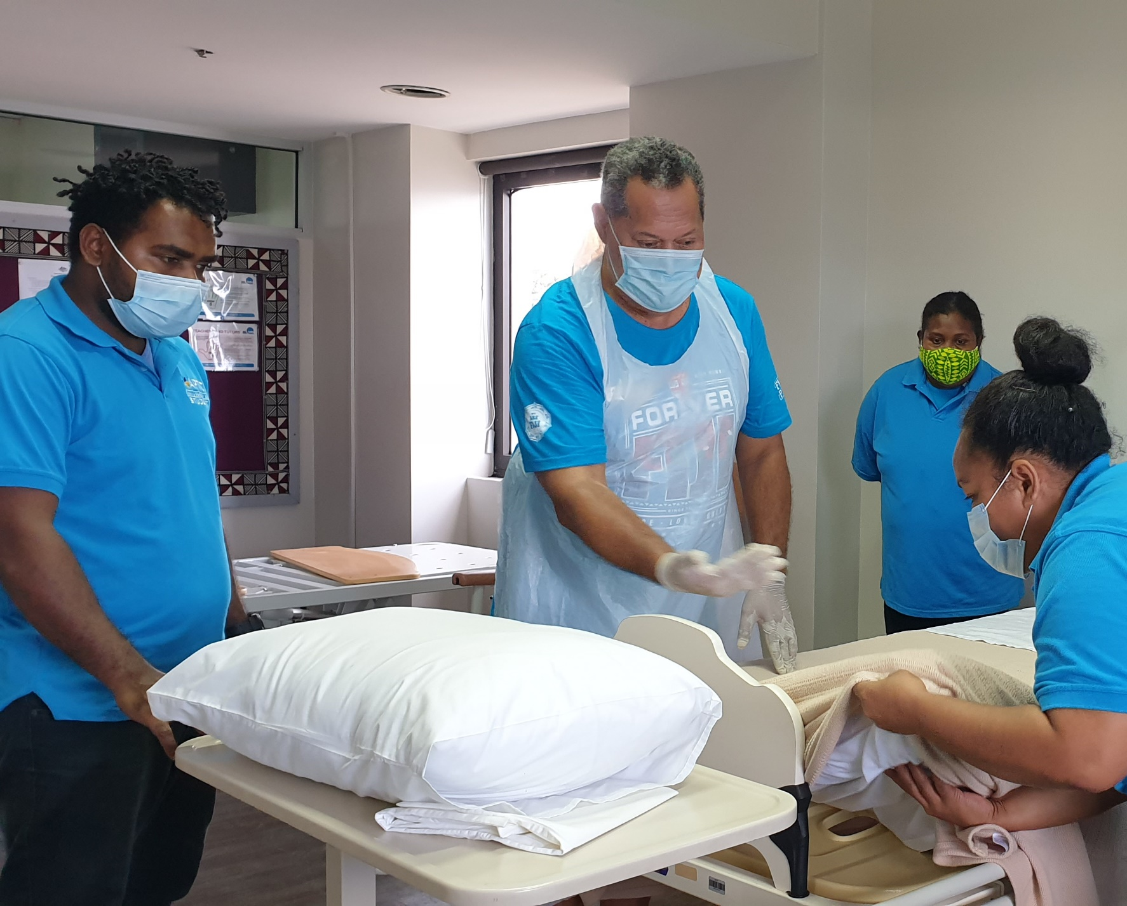
Closing Remarks
DFAT Representative

